Slide 1
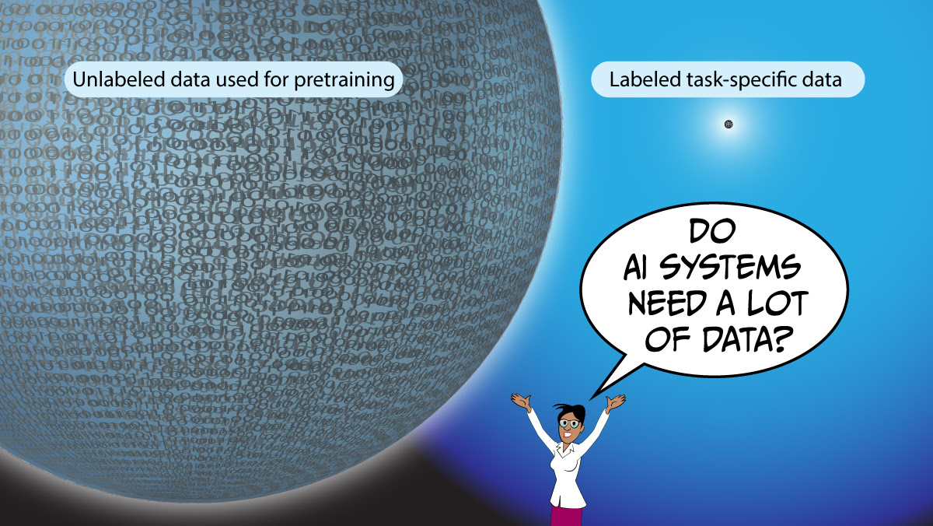
“Unsupervised” DL
Self-supervised learning
Generative models
Autoencoders
Reinforcement learning

Slide 2
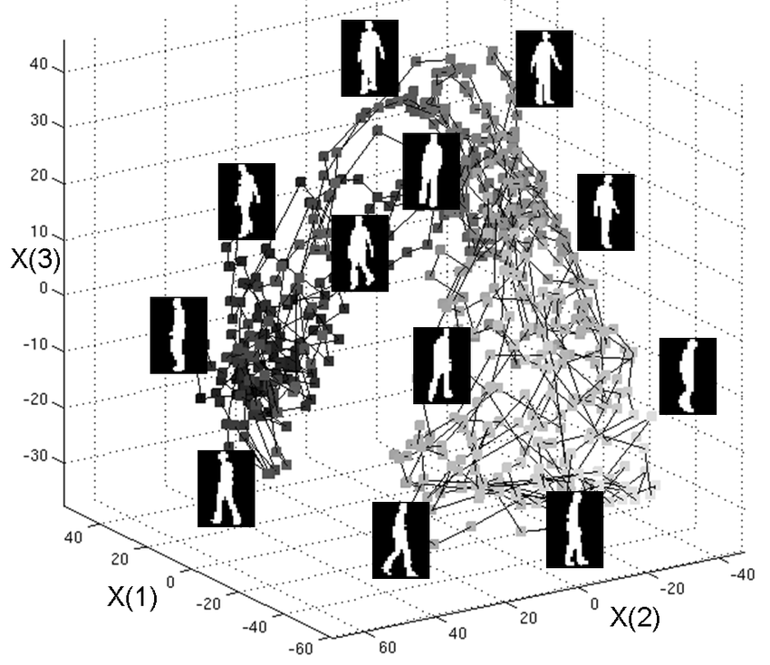
Unsupervised DL
So far we looked at supervised deep neural models, either for classification or regression
In unsupervised learning, we have only example instances but no outputs
High-dimensional inputs typically live in a (nonlinear) low-dimensional manifold
The goal of unsupervised (DL) learning is to discover this manifold: dimensionality reduction
Another applications of such models is to generate new examples of instances.

Slide 3
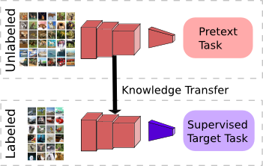
Self-Supervised Learning
If we have Labeled Data, it’s Supervised Learning
If data doesn’t have any labels, it’s Unsupervised Learning
Self-Supervised Learning exploit a variety of “hidden” labels that come with the data for free (e.g. word2vec)
We invent a “pretext” task on the data (e.g. rotate images at random) and apply some learning (supervised or not) on it
Performance of the pretext task is not so important, rather we are interested in the learned intermediate representation
We use this robust representation through transfer learning in a variety of practical downstream tasks
https://amitness.com/2020/02/illustrated-self-supervised-learning/
https://amitness.com/2020/05/self-supervised-learning-nlp/
https://amitness.com/knowledge-transfer/

Slide 4
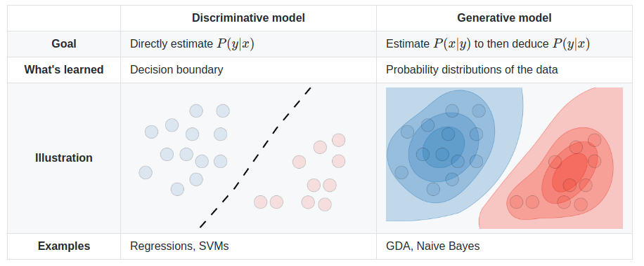
Discriminative vs Generative models

Slide 5
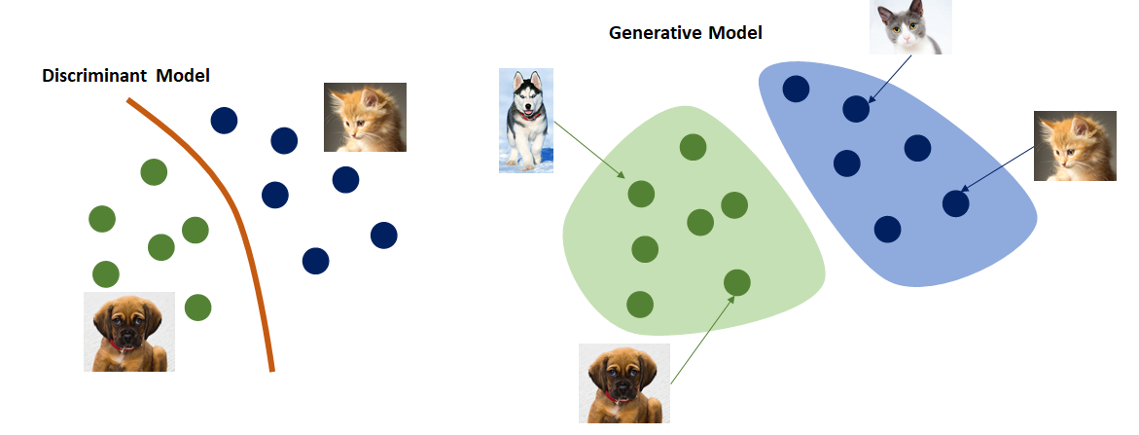
A generative model can also generate samples
P(class|data)
P(data|class)
Generative models tackle a more difficult task than analogous discriminative models. Generative models have to model more.

Slide 6
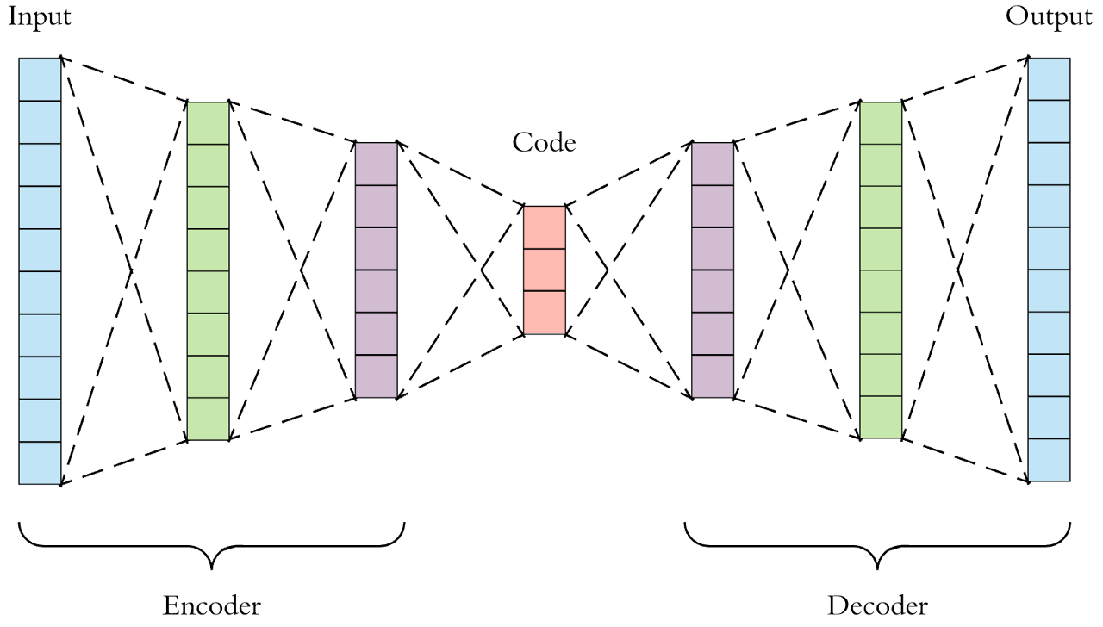
Autoencoders
A neural network architecture such that we impose a bottleneck in the network forcing a compressed knowledge representation of the original input on the manifold
Self-supervised
Generative

Slide 7
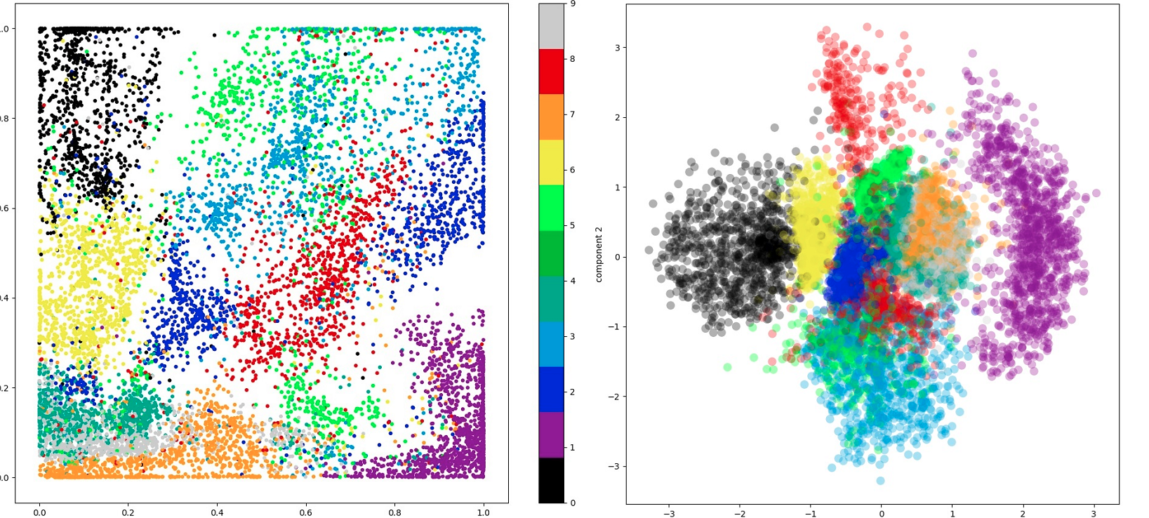
Variational Autoencoders
Autoencoders can be seen as a nonlinear PCA
The distribution of the latent variable produced by the encoder can be complicated
Variational autoencoders model the latent dimensional as a pdf, where samples of the same class are close to each other in the latent space: generative models
Latent space for “Minst”:
Autoencoder (left)
Variational Autoencoder (right)

Slide 8
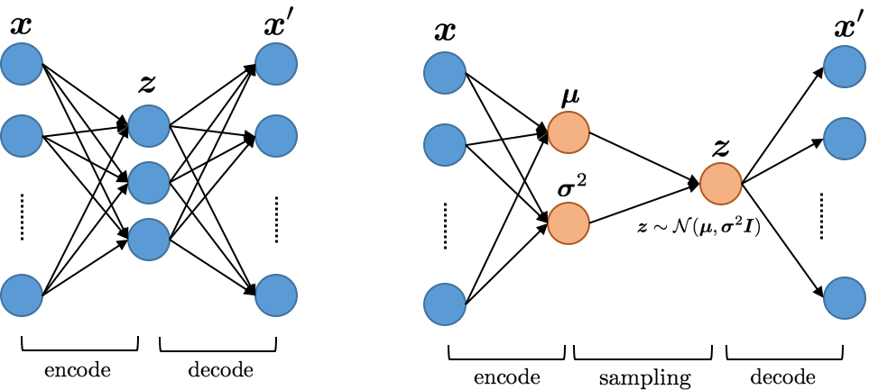
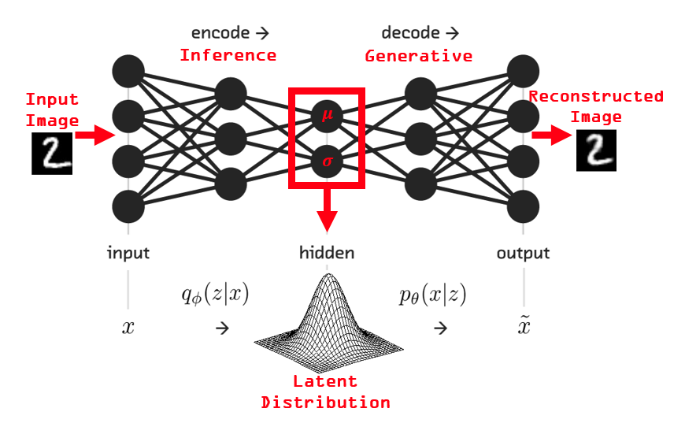
Autoencoder vs Variational AE

Slide 9
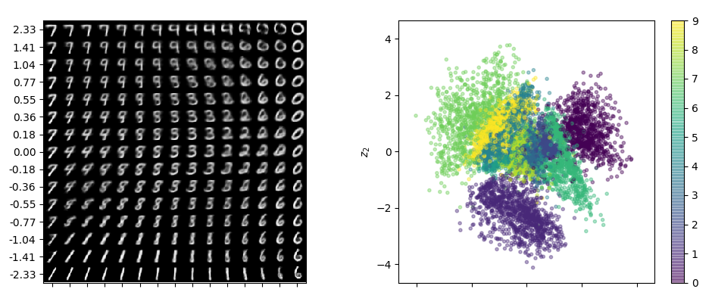
VAEs are Generative Models
Generative models can be considered as self-supervised, but with different goals:
Generative models focus on creating diverse and realistic images
Self-supervised representation learning care about producing good features for many tasks

Slide 10
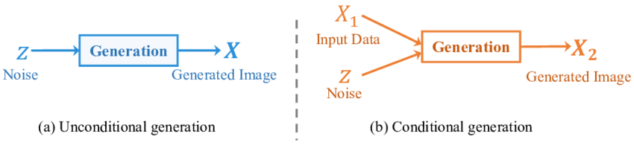
But the encoded representation is not “controlled”, we would like that each latent attribute controls some attribute through a probability distribution.
Therefore, we could sample from each latent state distribution to generate “controlled” inputs for the decoder.

Slide 11
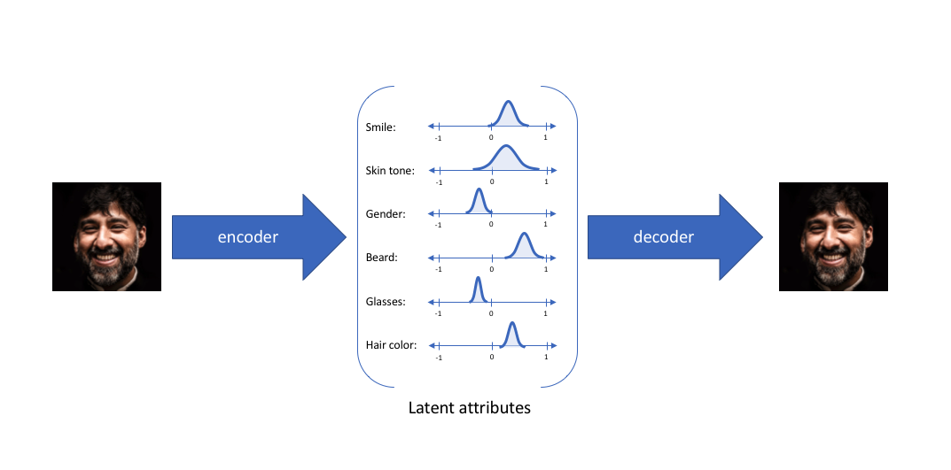
Conditional Autoencoder

Slide 12
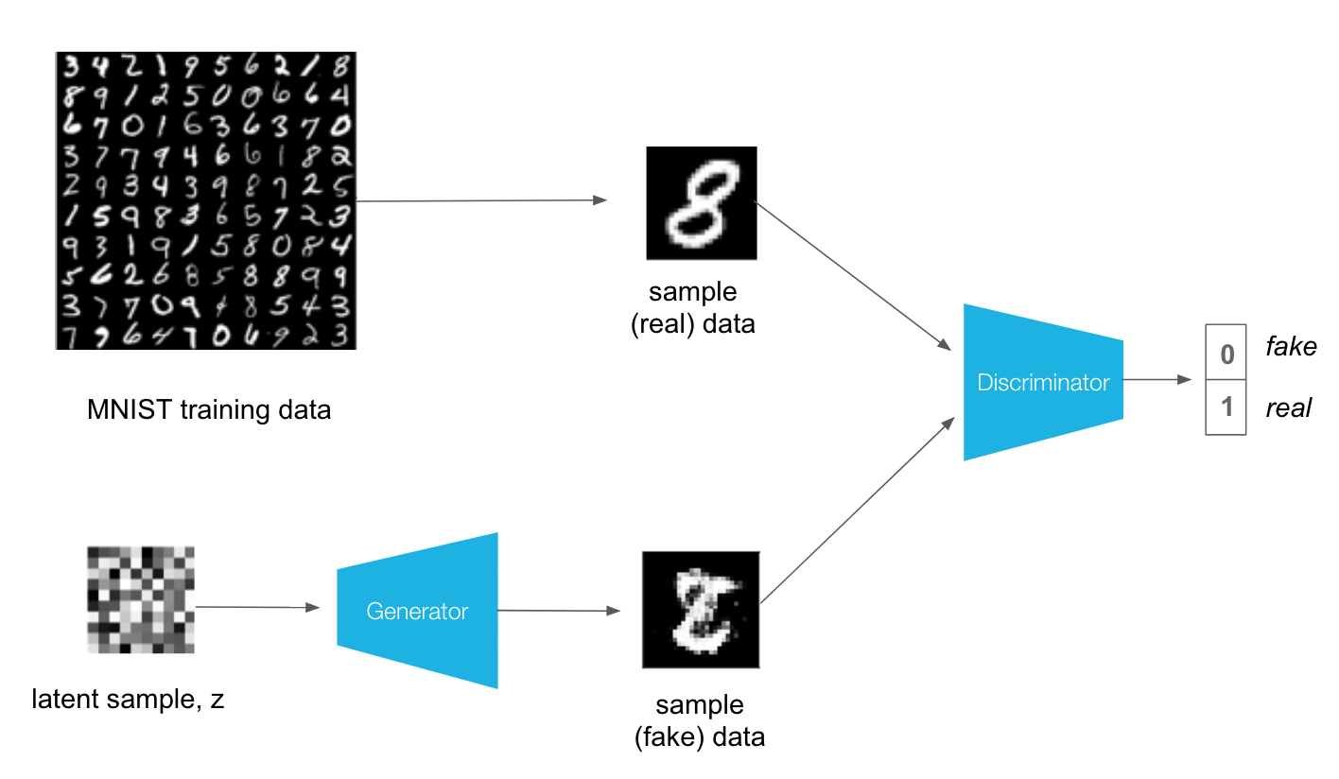
Generative Adversarial Models (GANs)
GANs are unsupervised learning algorithms but use a supervised loss trained together with the generative model in an adversarial manner (game theory)

Slide 13
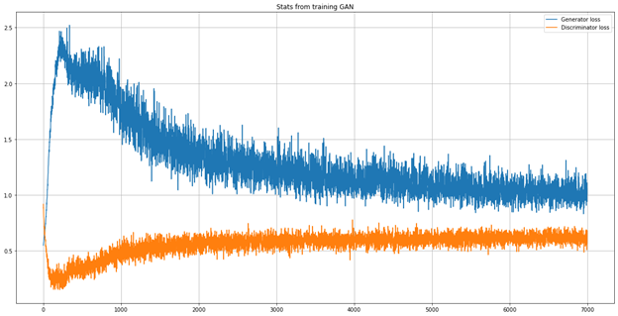
A generative adversarial network (GAN) has two parts:
The generator learns to generate plausible data. The generated instances become negative training examples for the discriminator.
The discriminator learns to distinguish the generator's fake data from real data. The discriminator penalizes the generator for producing implausible results.
Generator Loss
Discriminator Loss
The generator learns to fool the discriminator
Alternating Training
The generator and the discriminator have different training processes. So how do we train the GAN as a whole?
GAN training proceeds in alternating periods:
The discriminator trains for one or more epochs.
The generator trains for one or more epochs.
Repeat steps 1 and 2.

Slide 14
Diffusion models are autoencoders
The Illustrated Stable Diffusion – Jay Alammar
Diffusion models are autoencoders – Sander Dieleman
High-performance image generation using Stable Diffusion in KerasCV

Slide 15
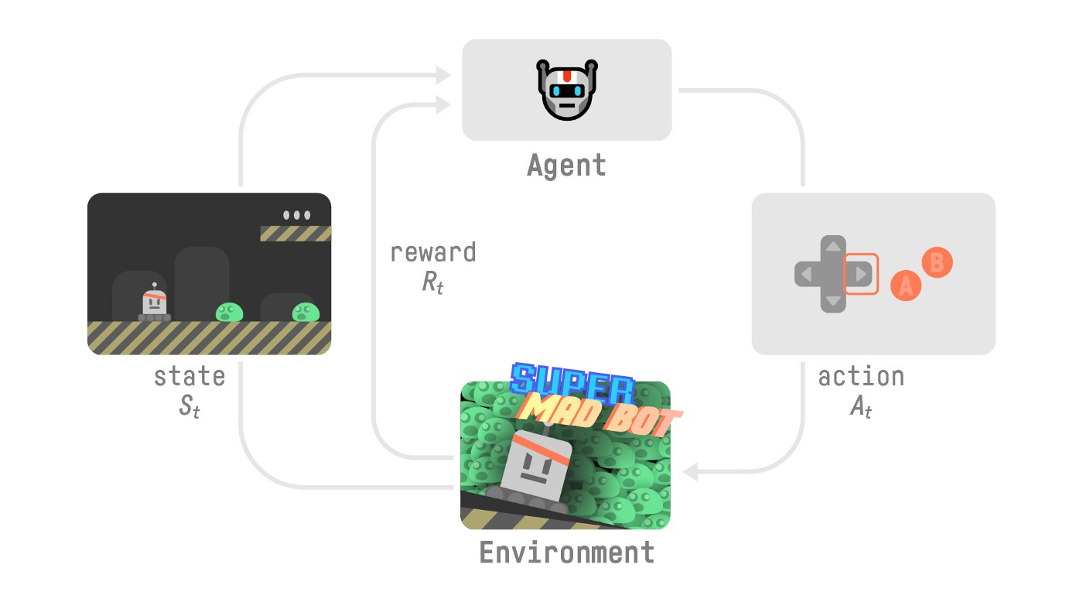
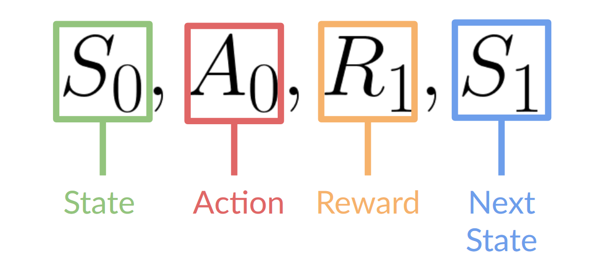
(DL) Reinforcement Learning
The idea behind Reinforcement Learning is that an agent (an AI) will learn from the environment by interacting with it (through trial and error) and receiving rewards (negative or positive) as feedback for performing actions (instead of labels).
Learning from interaction with the environment comes from our natural experiences.
The label RL uses rewards and penalties instead of labels
https://huggingface.co/blog/deep-rl-intro

Slide 16
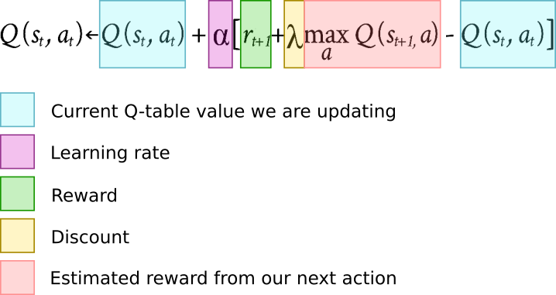
What is Q-learning?
The “information you have” gathered from your previous games, encoded into a table.
Value of an action = Immediate value + sum of all optimal future actions
Update the value estimation of an action based on the reward we got and the reward we expect next.
The discount will define how much we weigh future rewards over the one we just experienced.
The learning rate is like in gradient descent.

Slide 17
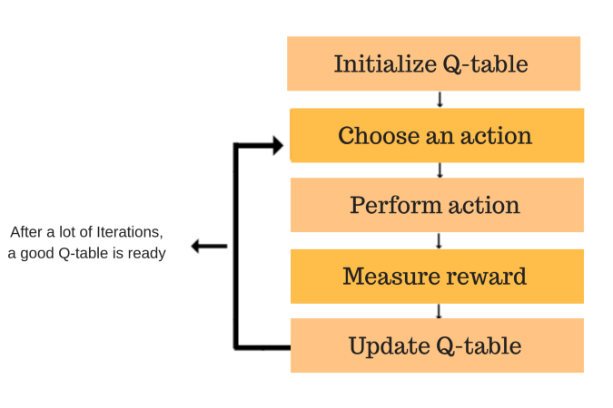
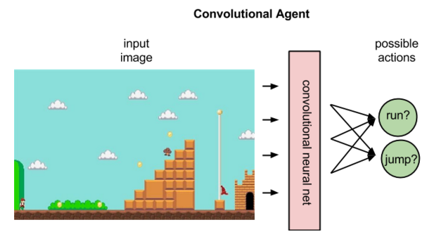
Learning Q from trial and error (no targets)
Q-table score will be the maximum expected future reward that the robot will get if it takes that action at that state. This is an iterative process, as we need to improve the Q-Table at each iteration.
This feedback loop is analogous to the backpropagation of error in supervised learning

Slide 18
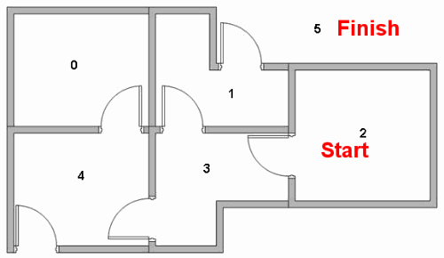
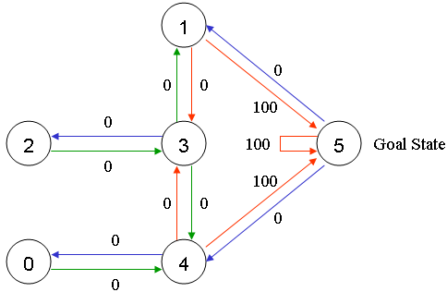
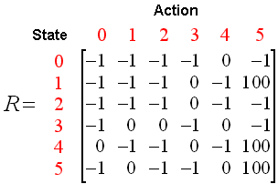
Example

Slide 19
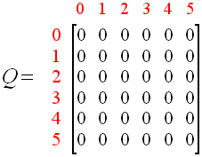
Example: an episode (epoch)
100
S0 = 1
S1 = random({3,5}) = 5
Q(state, action) = R(state, action) + Gamma * max[Q(next state, all actions)]
Q(1, 5) = R(1, 5) + 0.8 * max[Q(5, 1), Q(5, 4), Q(5, 5)] = 100 + 0.8 * 0 = 100
STOP
Since matrix Q is still initialized to zero, Q(5, 1), Q(5, 4), Q(5, 5), are all zero. The result of this computation for Q(1, 5) is 100 because of the instant reward from R(5, 1)

Slide 20
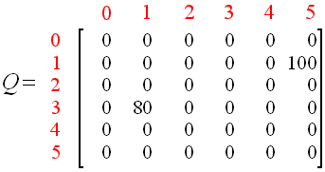
Example: next episode (epoch)
100
S0 = 3
S1 = random({1,2,4}) = 1
Q(state, action) = R(state, action) + Gamma * Max[Q(next state, all actions)]
Q(3, 1) = R(3, 1) + 0.8 * Max[Q(1, 3), Q(1, 5)] = 0 + 0.8 * Max(0, 100) = 80
S2 = 1 (The next state, 1, now becomes the current state.)
….
We use the updated matrix Q from the last episode. Q(1, 3) = 0 and Q(1, 5) = 100. The result of the computation is Q(3, 1) = 80 because the reward is zero.

Slide 21
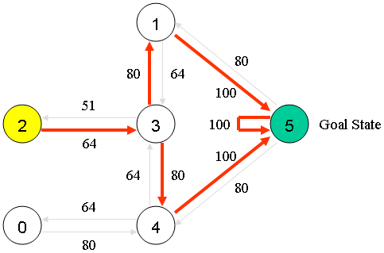
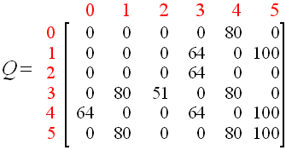
The (normalized) Q matrix after several episodes
We can simply choose to perform the action with the highest value from a state. (Greedy)

Slide 22
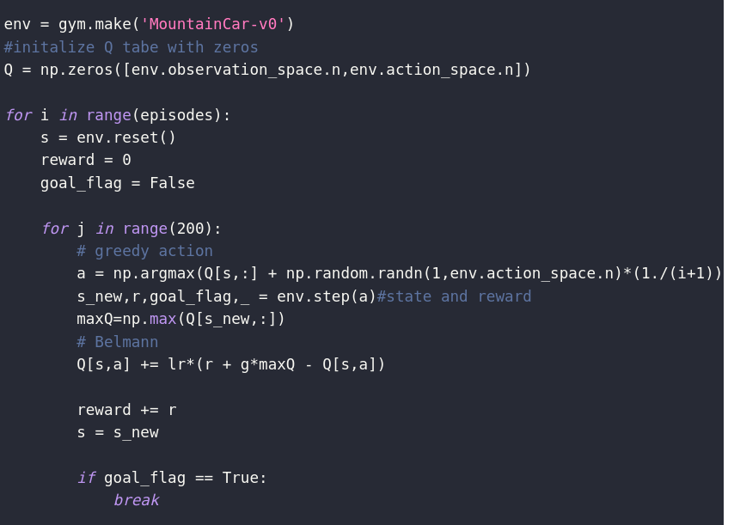
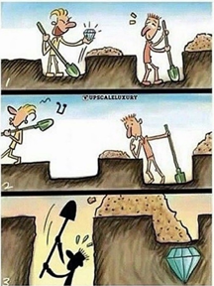
Exploration vs Exploitation
The algorithm, as described above, is a greedy algorithm, as it always chooses the action with the best value. But what if some action has a very small probability to produce a very large reward? The agent will never get there. This is fixed by adding random exploration. Every once in a while, the agent will perform a random move, without considering the optimal policy. But because we want the algorithm to converge at some point, we lower the probability to take a random action as the game proceeds.

Slide 23
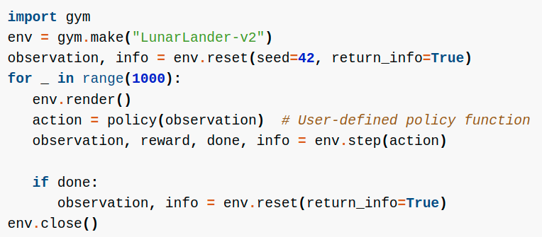
Gym is a standard API for reinforcement learning, and a diverse collection of reference environments

Slide 24
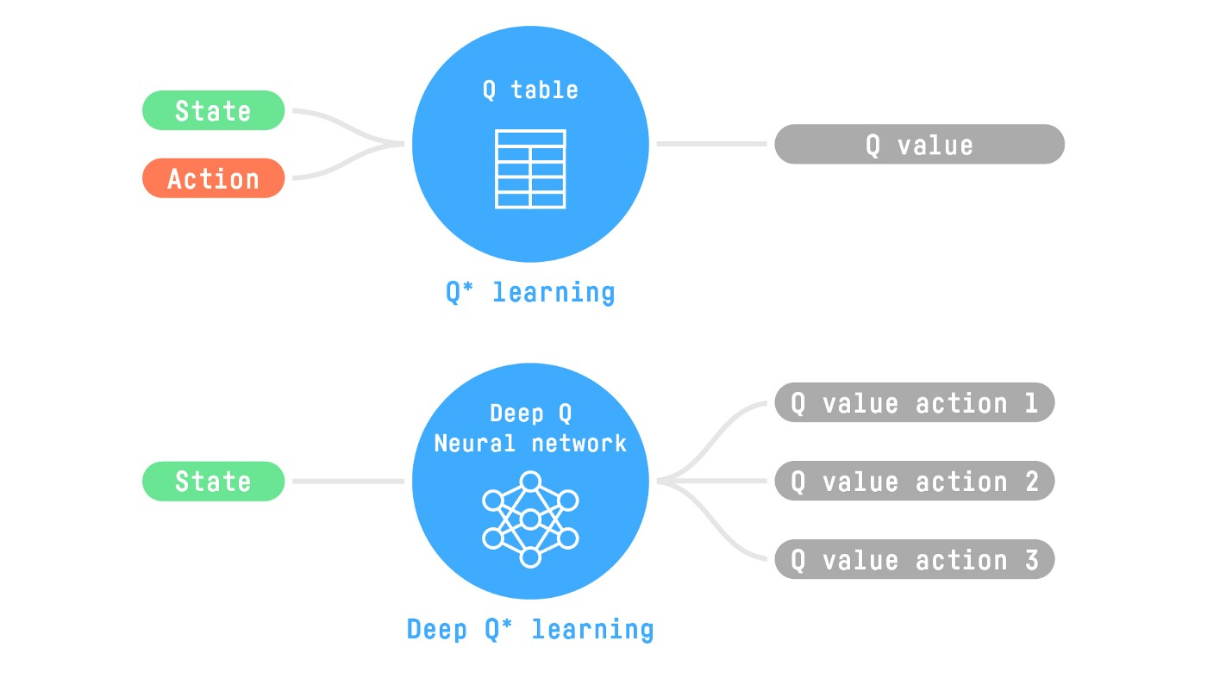
Q-learning vs deep Q-learning
In practice we may have infinite states (images) and actions
We’ll use a deep NN to produce a Q-function instead of a Q-table
(or to map a state to an action)

